Slide 1
Single Source Shortest Path

Slide 2
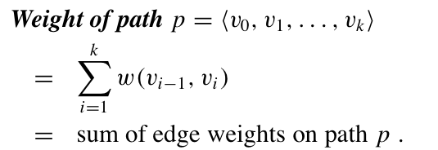
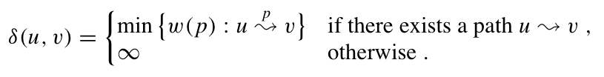
Shortest Path
Given a graph (directed or undirected) G = (V, E) with weight function w: E → R and a vertex s∈V, find for all vertices v∈V the minimum possible weight for path from s to v.
Shortest path weight:

Slide 3
Shortest Path Problems
Shortest-Path problems
Single-Source (Single-Destination): Find a shortest path from a given source (vertex s) to each of the vertices.
Single-Pair: Given two vertices, find a shortest path between them. Solution to single-source problem solves this problem efficiently, too.
All-Pairs: Find shortest-paths for every pair of vertices. Dynamic programming algorithm.

Slide 4
Shortest Path Applications
for weighted, directed graph G=(V,E)
Weight ~ Cost ~ Distance
Road maps
Airline routes
Telecommunications network routing
VLSI design routing

Slide 5
Negative-weight Edges
Some edges may have negative weights
If there is a negative cycle reachable from s:
Shortest path is no longer well-defined
Otherwise, it is fine

Slide 6
Cycles
Shortest path cannot have cycles inside
Negative cycles : already eliminated
Positive cycles: can be removed
0-weight cycles: can be removed
So each shortest path does not have cycles

Slide 7
Optimal Substructure Property
Given a shortest path, any subpath is also a shortest path between corresponding nodes

Slide 8
Shortest-paths Tree
For every node v ∈ V, π[v] is the predecessor of v in shortest path from source s to v
Nil if does not exist
All our algorithm will output a shortest-path tree
Root is source s
Edges are (π[v] , v)
The shortest path between s and v is the unique tree path from root s to v.

Slide 9
Goal:
Input:
directed weighted graph G = (V, E), source node s ∈ V
Output:
For every vertex v ∈ V,
d[v] = δ (s, v)
π[v]
Shortest-paths tree induced by π[v]

Slide 10
General Results (Relaxation)
Lemma 24.1: Let p = ‹v₁, v₂, …, v_{k}› be a SP from v₁ to v_{k}. Then,
p_{ij} = ‹v_{i}, v_{i+1}, …, v_{j}› is a SP from v_{i} to v_{j}, where 1 ≤ i ≤ j ≤ k.
So, we have the optimal-substructure property.
Bellman-Ford’s algorithm uses dynamic programming.
Dijkstra’s algorithm uses the greedy approach.
Let δ(u, v) = weight of SP from u to v.
Corollary: Let p = SP from s to v, where p = s u →v. Then,
δ(s, v) = δ(s, u) + w(u, v).
Lemma 24.10: Let s ∈ V. For all edges (u,v) ∈ E, we have
δ(s, v) ≤ δ(s, u) + w(u,v).

Slide 11
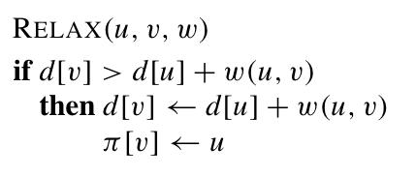
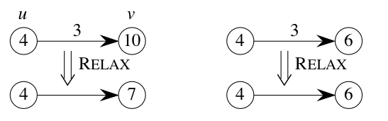
Basic Operation: Relaxation
Maintain shortest-path estimate d[v] for each node
d[v]: initialize ∞
Intuition:
Do we have a
shorter path
if use edge (u,v) ?

